Slide 1

Code-alpha
A Web-Based Code Editor
Guided by:
Er. Aditya Sharma

Slide 2

Our Team members & Roles
Sonu (Frontend Developer)
Prashant (Middleware + API)

Slide 3
Table of contents
1. Introduction
2. Objective
3. Tech-stack
4. Features
5. Achievement
6. conclusion

Slide 4
Introduction
The Online Code Editor is a dynamic web-based platform designed to facilitate coding, compilation, and execution of code snippets in various programming languages. Welcome to "Code Alpha" an innovative online code editor designed to revolutionize the way we code and collaborate. Code Alpha emerges as a response to the evolving needs and challenges faced by developers in the dynamic world of coding. This online code editor is not just a tool; it's a comprehensive solution

Slide 5

Technology stack
FRONTEND & UI/UX
middleware
HTML
CSS
Bootstrap
JavaScript
JavaScript (Middleware API)
Node.js
Code-Mirror
Compilex

Slide 6

Objectives of code-alpha
Multi-Language Support
Code Compilation and Execution
Syntax Highlighting
User-Friendly Code Editor
Output Display
Responsive Design
Text Coloring is also available

Slide 7
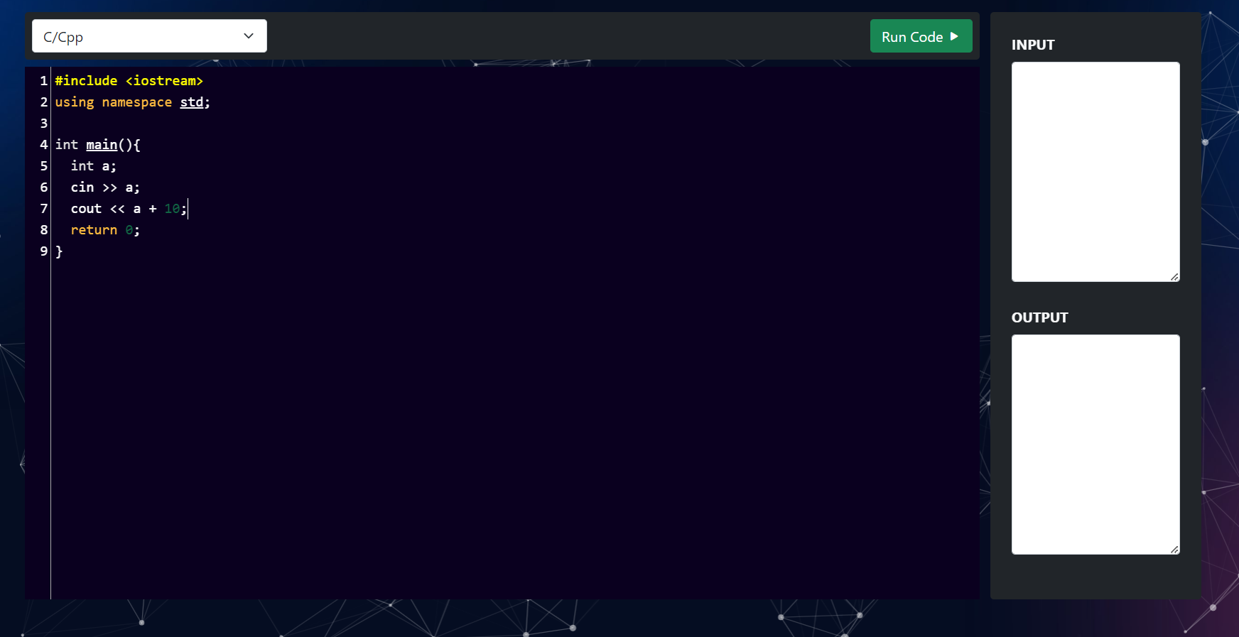
Achievement
Current Status
HTML
CSS
Bootstrap
JavaScript Frontend
UI Designing

Slide 8
conclusion
Provides traditional coding experiences, seamlessly blending simplicity with the power to compile and run code across multiple languages.
Array of features cater to both beginners and advanced coder.
Instant compilation and code running, facilitating quick testing.
Allow students to focus solely on writing code without dealing with complex setup processes.
The Code-Alpha opens doors to endless coding opportunities, fostering innovation and exploration.

Slide 9

Thankyou

